Slide 1
International Economics
Trade, The Balance of Payments and Exchange Rates

Slide 2
Trade
Buying and selling goods and services from other countries
The purchase of goods and services from abroad that leads to an outflow of currency from the UK – Imports (M)
The sale of goods and services to buyers from other countries leading to an inflow of currency to the UK – Exports (X)

Slide 3
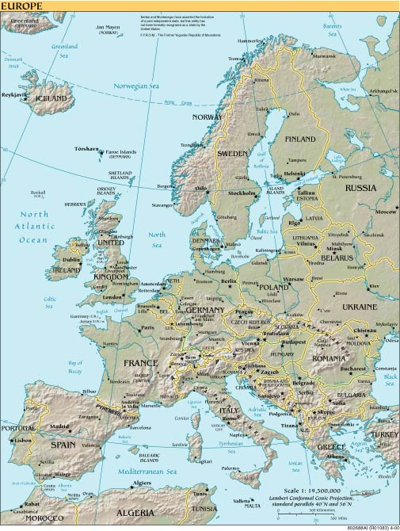
The Flow of Currencies:
Whisky sold to Italian hotel
Export earnings for UK
(Credit on Balance
of Payments)
€ changed to £
Map courtesy of http://www.theodora.com

Slide 4
The Flow of Currencies:
Oil from Russia
Oil
£ changed into Roubles
Export earnings for Russia
Import expenditure for the UK
(Debit on balance of payments)
Map courtesy of http://www.theodora.com

Slide 5
The Balance of Payments
A record of the trade between the UK and the rest of the world.
Trade in goods
Trade in services
Income flows
= Current Account
Transfer of funds and sale of assets and liabilities
= Capital Account

Slide 6
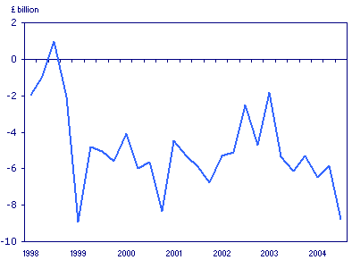
Balance of Payments
The UK Balance of Payments on Current Account 1998 - 2004
Source: ONS (http://www.statistics.gov.uk/cci/nugget.asp?id=194) (Crown copyright material is reproduced with the permission of the Controller of HMSO and the Queen's Printer for Scotland.)

Slide 7
Exchange Rates
The rate at which one currency can be exchanged for another e.g.
£1 = $1.90
£1 = €1.50
Important in trade

Slide 8
Exchange Rates
Converting currencies:
To convert £ into (e.g.) $
Multiply the sterling amount by the $ rate
To convert $ into £ - divide by the $ rate: e.g.
To convert £5.70 to $ at a rate of £1 = $1.90, multiply 5.70 x 1.90 = $10.83
To convert $3.45 to £ at the same rate, divide 3.45 by 1.90 = £1.82

Slide 9
Exchange Rates
Determinants of Exchange Rates:
Exchange rates are determined by the demand for and the supply of currencies on the foreign exchange market
The demand and supply of currencies is in turn determined by:

Slide 10
Exchange Rates
Relative interest rates
The demand for imports (D£)
The demand for exports (S£)
Investment opportunities
Speculative sentiments
Global trading patterns
Changes in relative inflation rates

Slide 11
Exchange Rates
Appreciation of the exchange rate:
A rise in the value of £ in relation to other currencies – each £ buys more of the other currency e.g.
£1 = $1.85 £1 = $1.91
UK exports appear to be more expensive ( Xp)
Imports to the UK appear to be cheaper ( Mp)

Slide 12
Exchange Rates
Depreciation of the Exchange Rate
A fall in the value of the £ in relation to other currencies - each £ buys less of the foreign currency e.g.
£1 = € 1.50 £1 = € 1.45
UK exports appear to be cheaper
( Xp)
Imports to the UK appear more expensive ( Mp)

Slide 13
Exchange Rates
A depreciation in exchange rate should lead to a rise in D for exports, a fall in demand for imports – the balance of payments should ‘improve’
An appreciation of the exchange rate should lead to a fall in demand for exports and a rise in demand for imports – the balance of payments should get ‘worse’ BUT

Slide 14
Exchange Rates
The volumes and the actual amount of income and expenditure will depend on the relative price elasticity of demand for imports and exports.

Slide 15
Exchange Rates
$ per £
S£
Assume an initial exchange rate of £1 = $1.85. There are rumours that the UK is going to increase interest rates
The rise in demand creates a shortage in the relationship between demand for £ and supply – the price (exchange rate) would rise
Investing in the UK would now be more attractive and demand for £ would rise
1.90
1.85
D£₁
Shortage
D£
Quantity on
ForEx Markets
Q1
Q3
Q2

Slide 16
Exchange Rates
Floating Exchange Rates:
Price determined only by demand and supply of the currency – no government intervention
Fixed Exchange Rates:
The value of a currency fixed in relation to an anchor currency – not allowed to fluctuate
Dirty Floating or Managed Exchange Rate:
– rate influenced by government via central bank around a preferred rate

